Slide 1




Music Recommendation system
SUDHA J

Slide 2


ABSTRACT
This code implements a song recommendation system using cosine similarity. It processes a dataset by removing duplicates, handling null values, and combining relevant columns into a single string for each song. After vectorizing these strings with CountVectorizer, it calculates similarity scores to create a matrix. Users can input a song name to receive the top 10 similar song recommendations based on these scores, with the option to repeat the process or exit.

Slide 3



INTRODUCTION:
This code introduces a song recommendation system that leverages cosine similarity to suggest songs similar to a user-provided input. It processes a dataset of songs, vectorizes combined song metadata, and calculates similarity scores between the songs. Users can enter a song name to receive recommendations for the top 10 most similar songs in the dataset, providing a personalized music discovery experience.

Slide 4

STEPS INVLOVED:
01
Data Collection
02
Data Preprocessing
03
Model Selection
04
Model Training
05
Model Evaluation

Slide 5
Building the Recommendation System
Step-by-Step Process of How the Recommendation System Works:
The system reads and preprocesses the dataset by removing duplicates, handling null values, and cleaning the "Artist Name" column. It combines relevant columns into a single "data" string for each song. The CountVectorizer then transforms these strings into numerical vectors, and cosine similarity is calculated to create a similarity matrix, which is used to find similar songs.

Slide 6

User Input and the Generation of Recommendations
The user inputs a song name, and the system checks if it exists in the similarity matrix. If found, the system retrieves the top 10 most similar songs and presents them to the user. If the song is not found, the user is prompted to enter another song. This process repeats until the user decides to stop, allowing for multiple recommendations in one session.

Slide 7
Key Components of the Code
The code includes data preprocessing to clean and prepare the dataset, vectorization to convert text data into numerical vectors, and similarity calculation to compute cosine similarity scores. The user interaction loop manages input, generates recommendations, and handles errors, ensuring a smooth and engaging experience for the user.

Slide 8
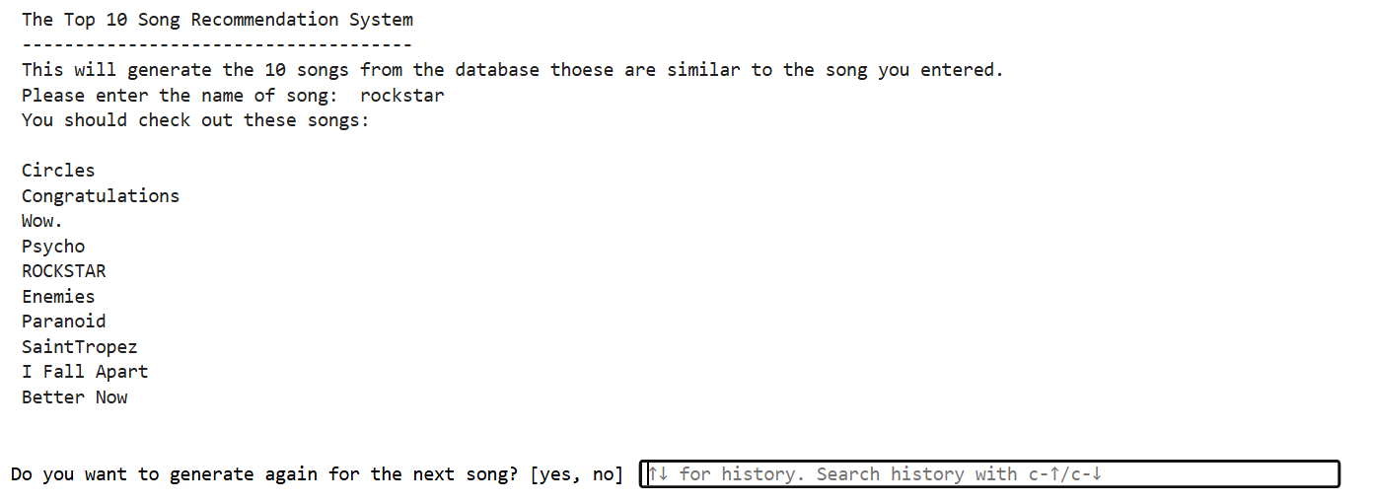
OUTPUT

Slide 9

CONCLUSION:
This song recommendation system effectively uses data preprocessing, vectorization, and cosine similarity to generate personalized music recommendations. By cleaning the dataset and converting song metadata into numerical vectors, it accurately finds and suggests similar songs based on user input. The interactive user loop ensures a smooth and engaging experience, highlighting the system's robustness and potential for future enhancements like expanding the dataset and integrating advanced algorithms for more tailored recommendations.

Slide 10
Thank You

